Slide 1

WELCOME TO,
Founder: Yash Chauhan
Co Founder: Rohan Mujoo

Slide 2
PROBLEM
Fraudulent practices in hospitality and tourism industry are a major cause of grievance for many tourists.
Dining Culture in India, in case of tourism, is still monopolized by 5 star hotels/high end restaurants due to which smaller business are overshadowed and usually aren’t able to stand out.
Lack of Understanding amongst younger children in the field of education due to lack of availability of technological aid.
Disconnect to the concepts being taught due to limited imagination of students due to inadequate material to supplement the concepts.

Slide 3
SOLUTION
Augmented Reality based visual aids would enable both tourism/hospitality and educational industry to overcome the issues by:
INSTALLING AR DRIVEN MAPS AND DIRECTIONAL CLUES
INSTALLING AR BASED HOARDINGS
THROUGHOUT THE CITY
REPLACING CONVENTIONAL VISUAL TEACHING AIDS WITH AR BASED AIDS
MAKING SCHOOL LABS USING THE CONCEPT OF AR i.e. AR ENABLED LABS

Slide 4
MARKET VALIDATION
100+
Prominent Hoarding Advertising Agencies in Jaipur Alone
Listed on Justdial
1500+
Registered Restaurants in Jaipur Alone
Listed on sites such as Justdial ,swiggy , zomato
1.5M+
Schools in India
Indian Census/DISE
13000+
Schools in Rajasthan
State brief information

Slide 5
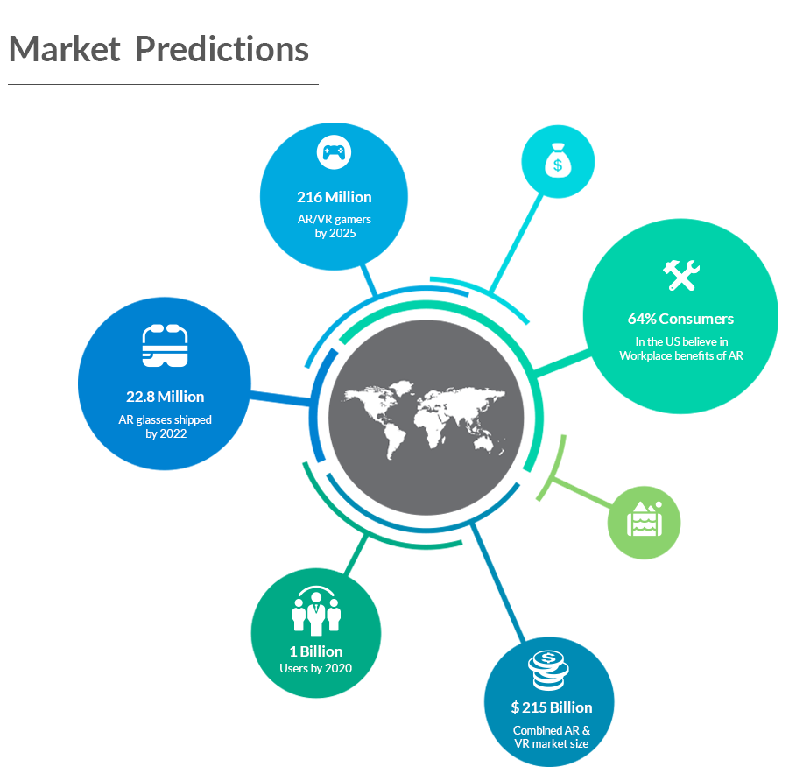
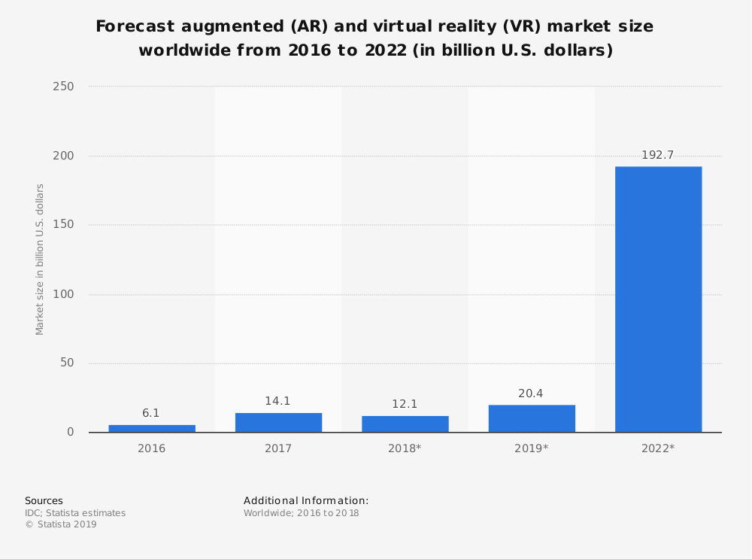
MARKET SIZE AND PROSPECTS
Ref: statista.com

Slide 6
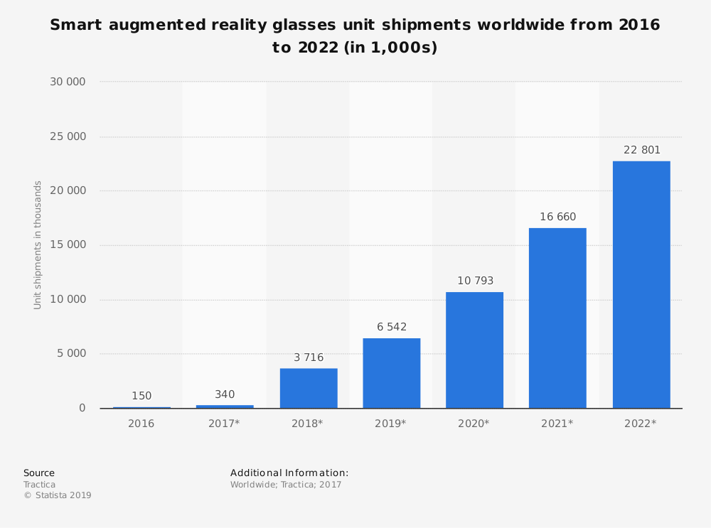
Software pioneers and giants such have also shown huge interest in the field of AR
Google launched AR framework AR core for Android AR experience
Apple launched AR framework AR Kit similar to google but for IOS
Microsoft has been hugely invested in AR and recently release Holo Lens 2
Amazon has its own AR development service available online
Smart augmented reality glasses unit shipments worldwide from 2016 to 2022 (in 1,000s)

Slide 7
REVENUE STREAM
We plan to offer multiple services
1.) Delivering the product.(AR based adverts. , Menus, Educational Models)
2.) Delivering the product + Offering maintenance (in case of educational sector).
3.)Updating of the AR designs with time to accommodate changes and trends.

Slide 8
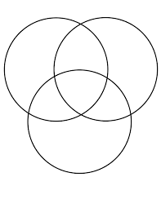
COMPETITION
A: Retail/Commercial
Imaginate
Lenskart
Yeppar
B: Development
iBoson Innovations
GMETRI Studios
Grey Kernel
GazeMatic
C: Industrial/Business
Scapic
Grey Kernel
GazeMatic
SmartVizX
A B
C

Slide 9
THANK YOU!

